Slide 1


Slide 2

Estimate store potential on Diapers for geolocal marketing plans
Università di Napoli Federico II

Slide 3
Case Study Challenge
Exploratory Data Analysis
Confirmatory Data Analysis
Conclusion
Contents

Slide 4

Case Study
Challenge

Slide 5
Introduction
The retail industry faces the challenge of optimizing product placement and promotional efforts specifically for diaper sales in the Naples province. This necessitates a strategic approach to resource allocation and market potential exploitation to enhance store performance.

Slide 6

Case Study
This involves a detailed analysis of factors influencing diaper sales at retail outlets in Naples, focusing on socio-demographic data, territorial features, and points of interest such as population composition, geographic and environmental characteristics, and the presence of nearby facilities and services.

Slide 7

Questions To Solve
The project aims to answer critical questions regarding the leverage of socio-demographic data for predicting sales, the impact of territorial features on store potential, the influence of points of interest on consumer behavior, and the development of predictive models for estimating sales potential.

Slide 8

Datasets Overview
The analysis is supported by a diverse set of data contained in multiple files:
Dictionary.xlsx: Provides a glossary of terms for dataset interpretation.
Gravitation_NA.csv: Quantifies store attractiveness based on proximity to points of interest and accessibility.
Shapes_NA.csv: Includes geographic information for spatial analysis.
Socio_Demo_NA.csv: Contains demographic information relevant to the target market.
Stores_NA.csv: Offers detailed data on each store's characteristics.

Slide 9

Next Step
The integration of these datasets is crucial for developing a strategic framework aimed at boosting diaper sales in Naples through targeted marketing and inventory strategies. This approach emphasizes the importance of combining socio-demographic insights, territorial mapping, and strategic points of interest analysis into a cohesive marketing strategy.

Slide 10

Exploratory
Data Analysis

Slide 11

Data Pre-Processing and Cleaning

Slide 12
Pre-Processing Importing libraries
sf: Manages spatial data for GIS tasks.
dplyr: Enables data manipulation and transformation.
ggplot2: Provides a flexible plotting system using a graphics grammar.
leaflet: Creates interactive web browser maps.
plotly: Generates customizable interactive plots.
cluster: Offers clustering analysis functions.
hrbrthemes: Adds themes and styles to ggplot2 plots.
rpart: Facilitates classification and regression tree modeling.
data.table: Enhances data frames for efficient manipulation, especially with large datasets.
caTools: Includes machine learning utilities like data splitting for training/testing.

Slide 13
Pre-Processing Importing Data
st_read() (sf package): Reads "shapes_NA.csv" into polygons_data, containing geographic polygon data.
read.csv(): Reads "stores_NA.csv" into stores_data, detailing store locations and attributes.

Slide 14
The process assigns microcodes to stores based on their location relative to polygons:
Initialize "microcode" Column: Adds "microcode" to stores_data, set to NA.
Spatial Join: Iterates through stores_data, creating point geometries for store locations.
Uses st_within() to check if stores are in any polygons_sf polygon, assigning matching microcodes to "microcode".
Export Results: Updates stores_data with microcodes and exports to "result.csv" without row names.
This approach spatially links stores to polygons, enriching store data with geographic microcodes.
Pre-Processing Assigning microcode
to store

Slide 15
The process involves reading data from CSV files and merging data frames based on a common column:
Read CSV Files:
df_socio from 'socio_demo_NA.csv': Contains socio-demographic data.
df_gravitation from 'gravitation_NA.csv': Contains data on gravitation.
df_store_microcode from 'result.csv': Contains store data with microcodes.
Merge Data Frames:
Performs a left join of df_store_microcode with df_socio on "microcode", resulting in merged_data. This retains all rows from df_store_microcode while adding matching socio-demographic data from df_socio.
This approach integrates socio-demographic information with store microcodes for comprehensive analysis.
Pre-Processing Joining Data

Slide 16
Removes specific unnecessary columns (Lat, Long, Provincia, province, region) from the dataframe.
Calculates total missing values in the dataset using is.na() and sum().
Determines missing values per column with is.na() and colSums().
Removes rows with any missing values using na.omit(), ensuring analysis is based on complete data to avoid biases or inaccuracies.
Data Cleaning

Slide 17
Descriptive Statistics

Slide 18
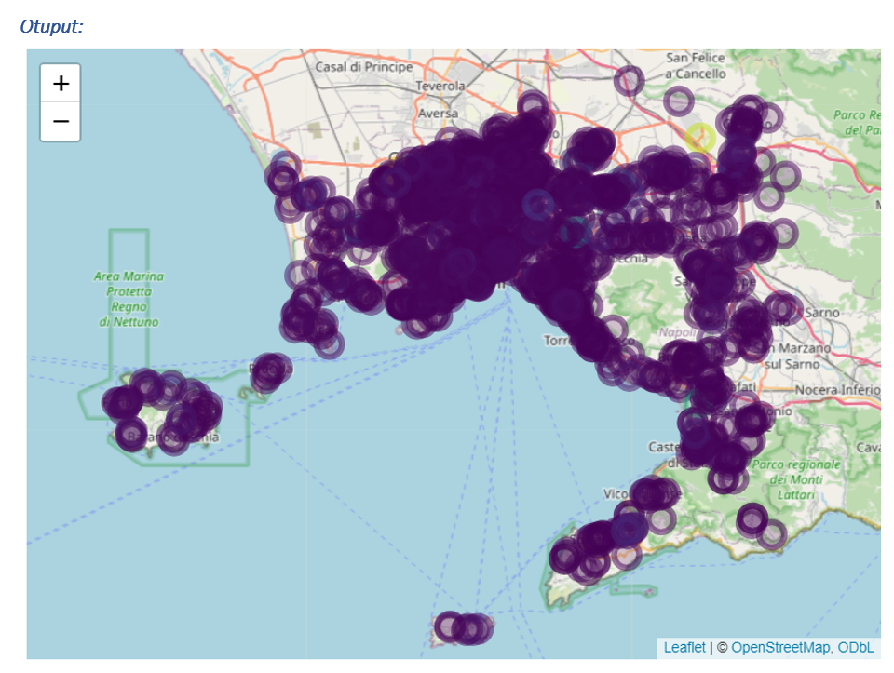
Graphicall representaion of Stores on map according to potential

Slide 19
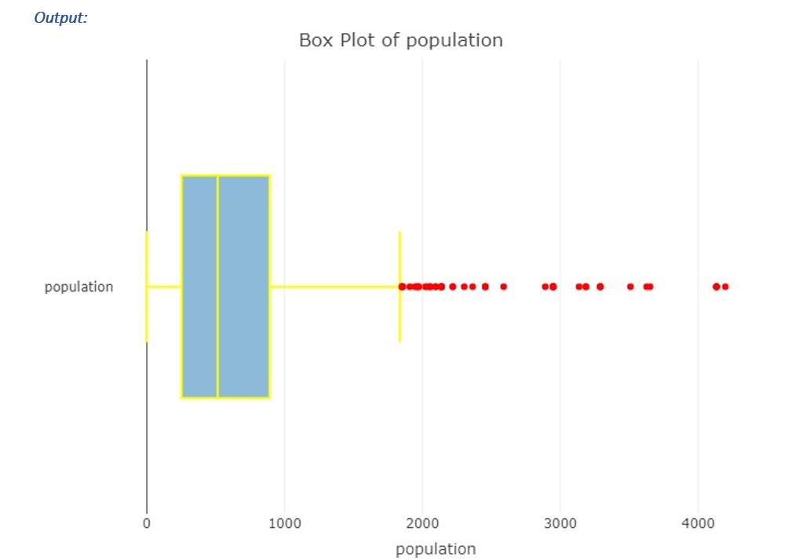
Box plots

Slide 20
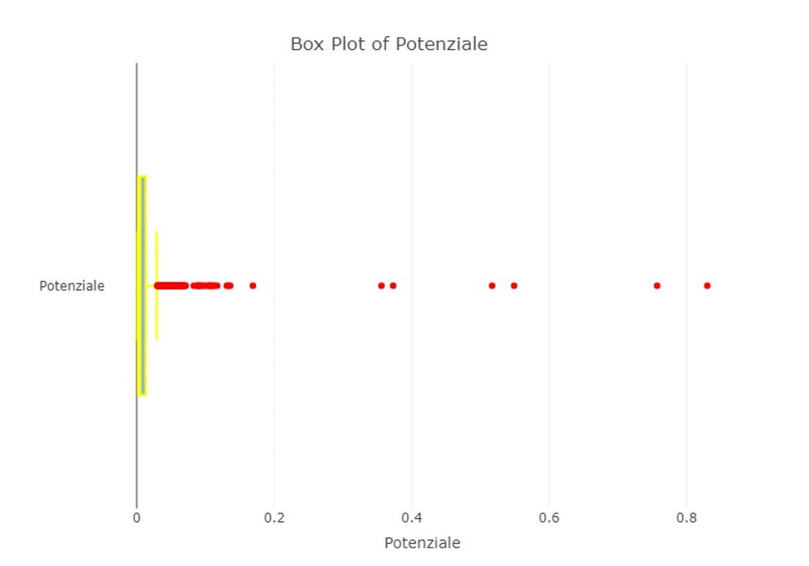
Box plots

Slide 21
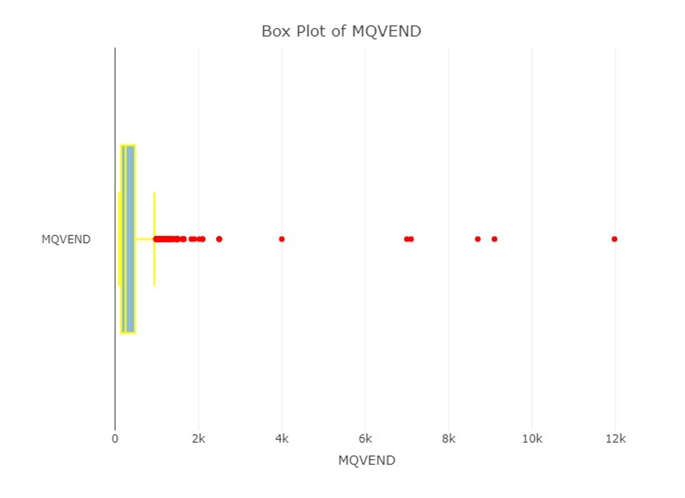
Box plots

Slide 22
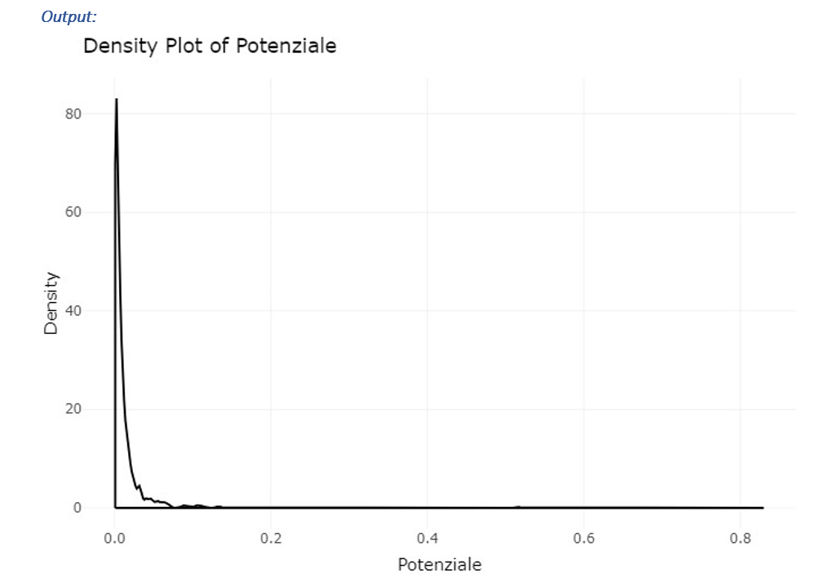
Density plot

Slide 23
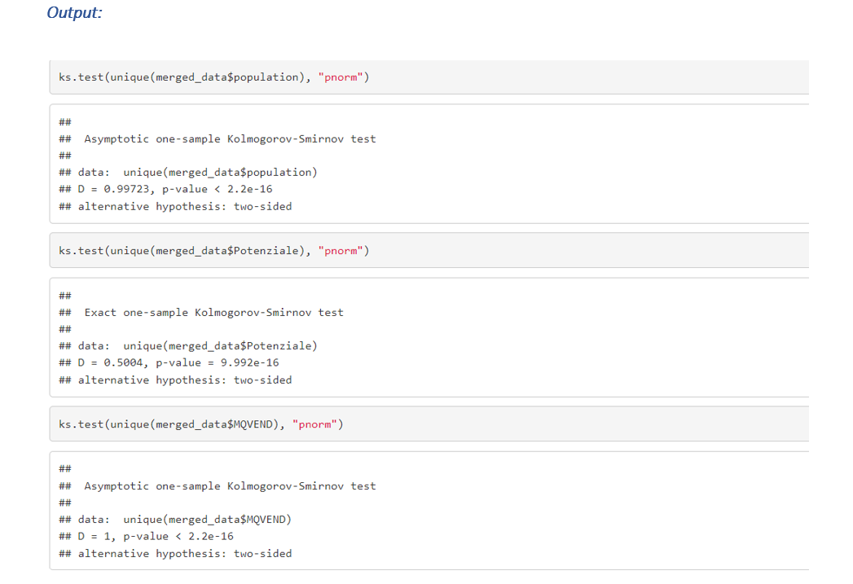
Normality testing

Slide 24
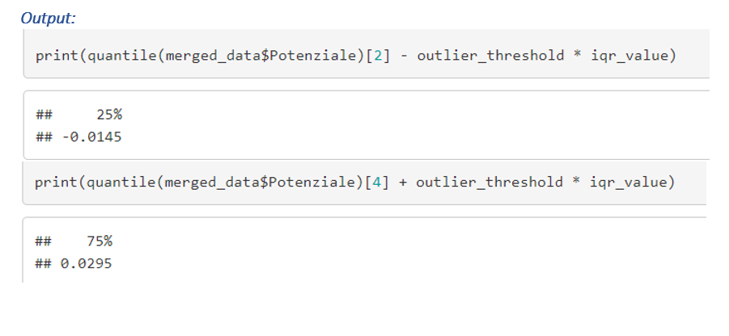
Removing Outliers

Slide 25
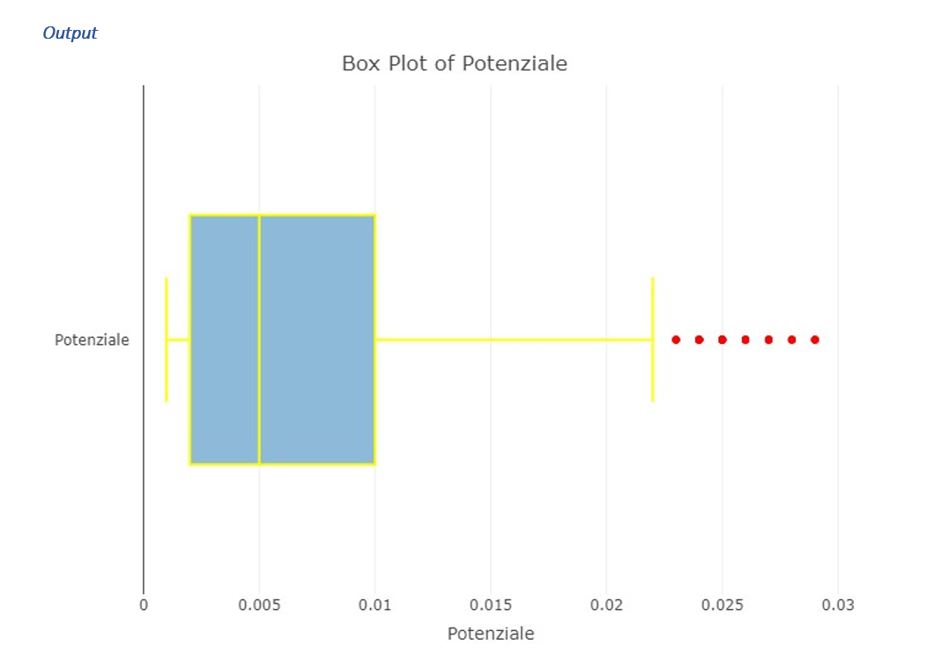
Box plot after removing outliers

Slide 26
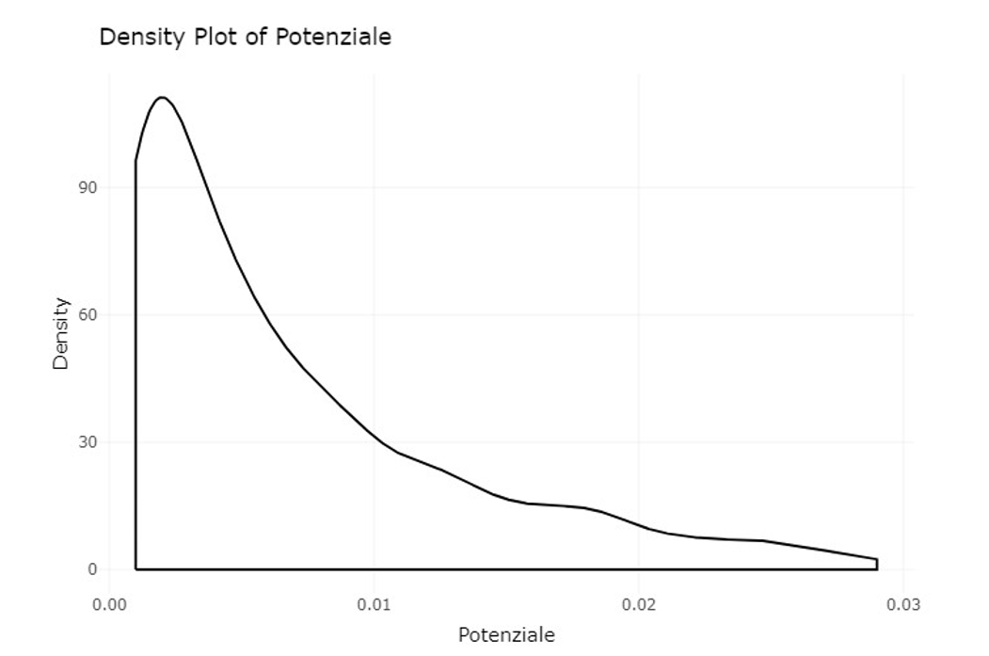
Density plot after removing outliers

Slide 27
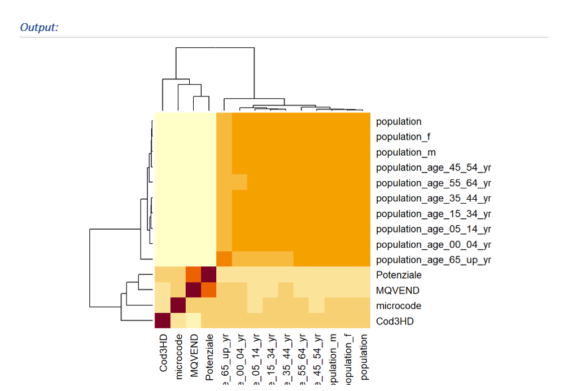
Correlation heatmap

Slide 28
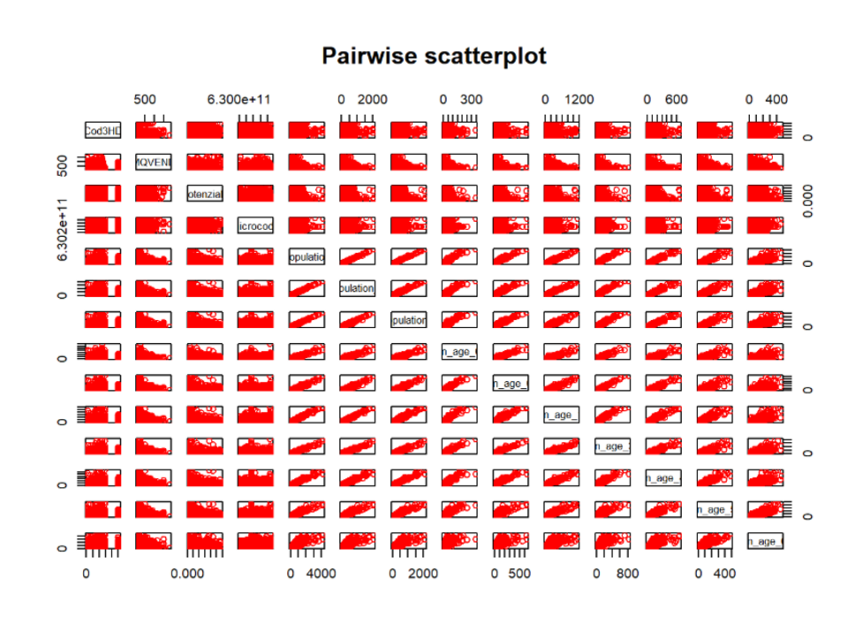
Pair-Plot

Slide 29
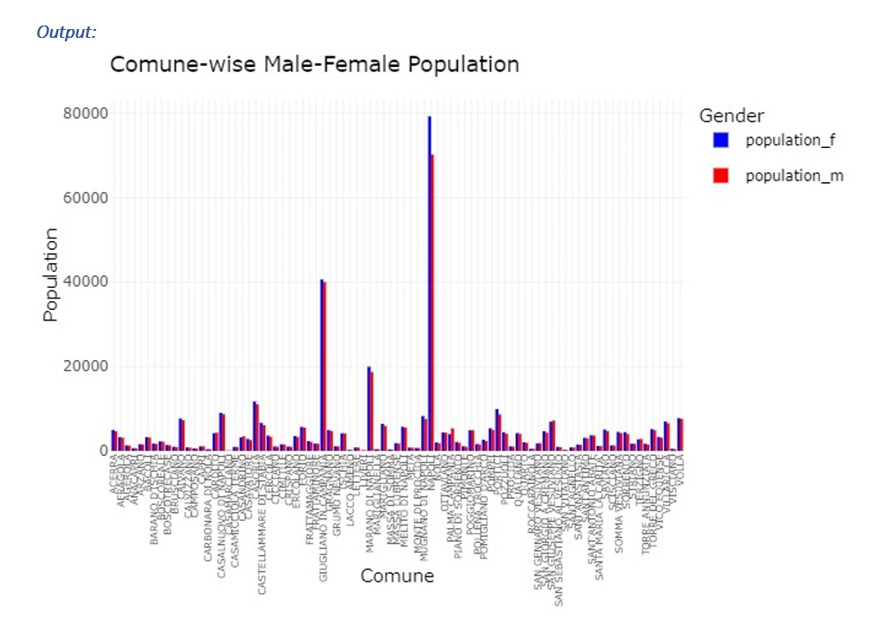
Comparison between male and female data

Slide 30
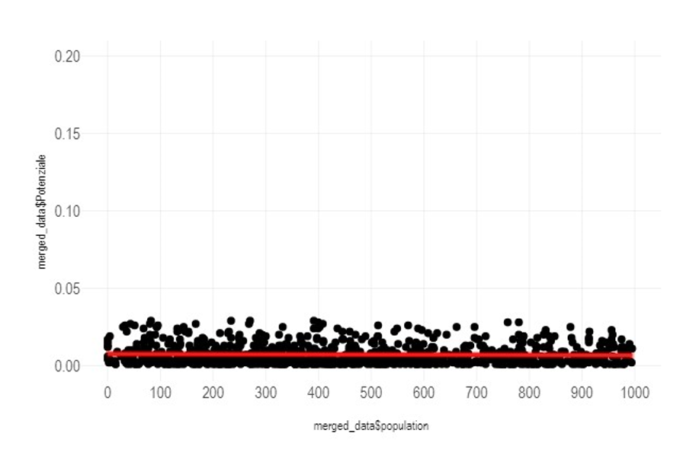
Comparison of Potential and Avg people population

Slide 31
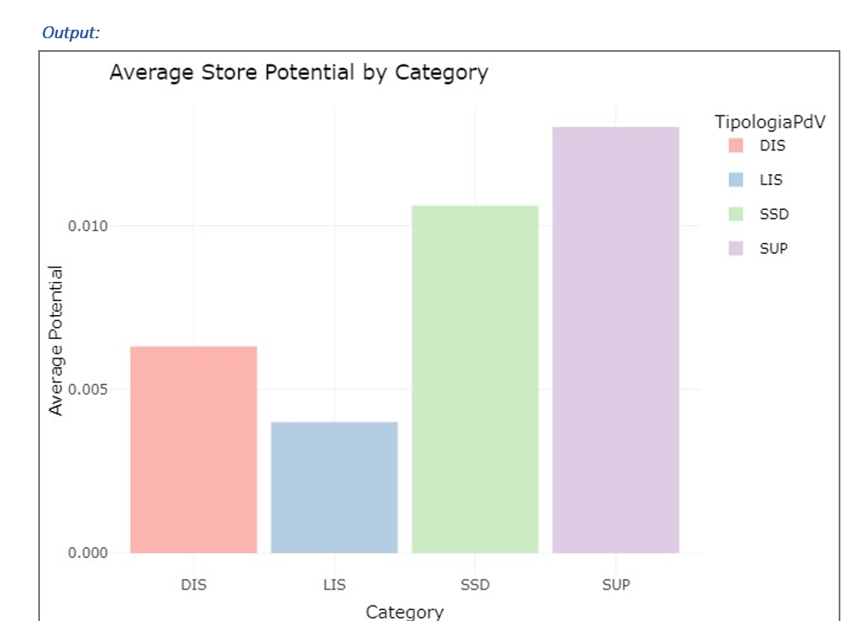
Average Store Potential by store Category

Slide 32
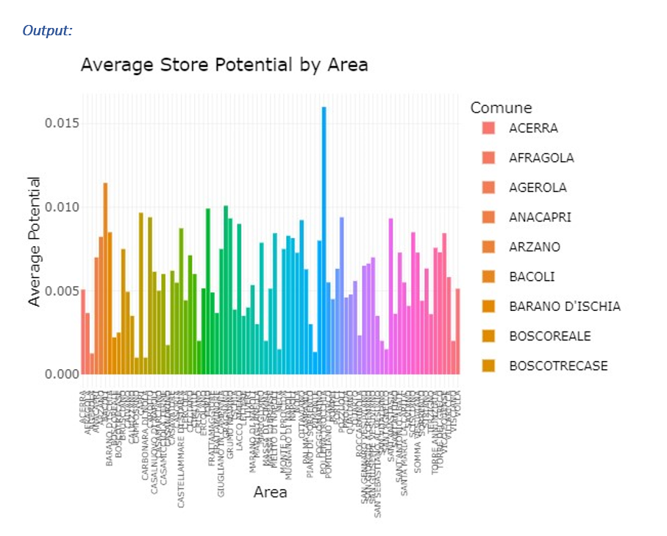
Average Store potential by Area

Slide 33
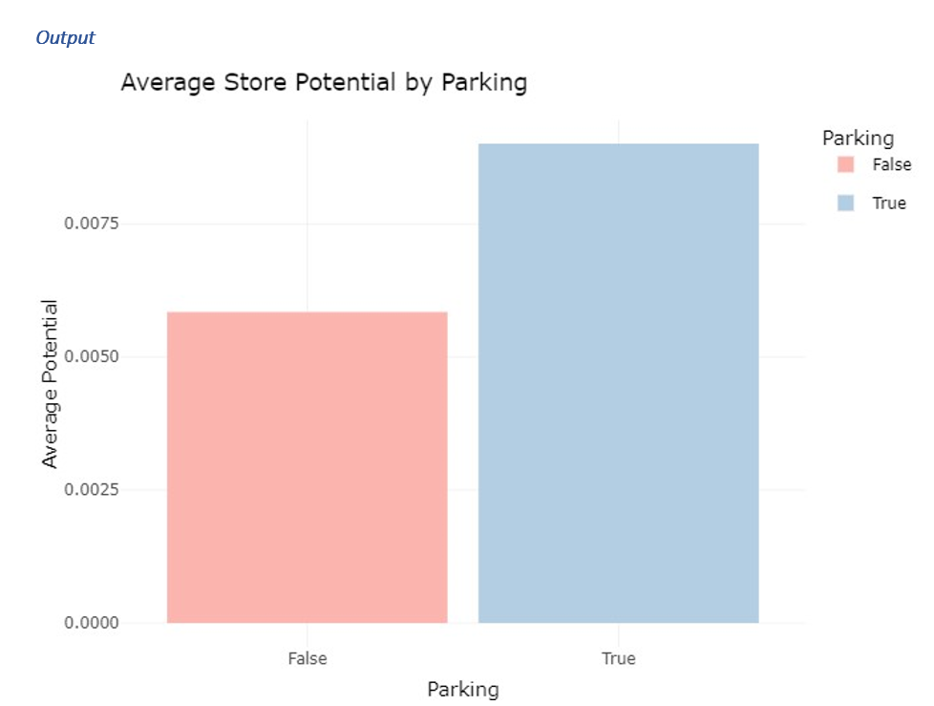
Average Store Potential by Parking

Slide 34
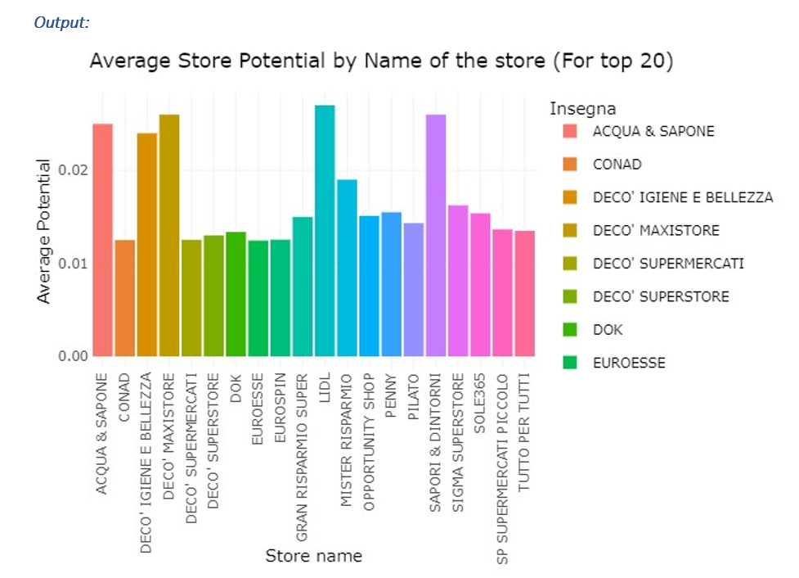
Average potential of store by name of the store

Slide 35
Feature Engineering and clustering

Slide 36
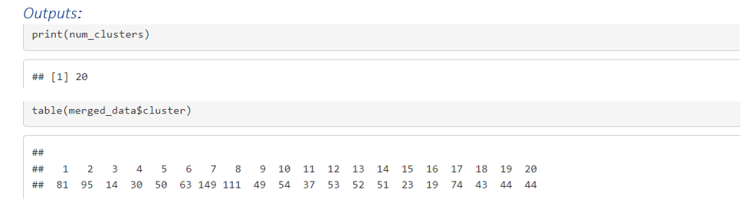
K-mean clustering

Slide 37
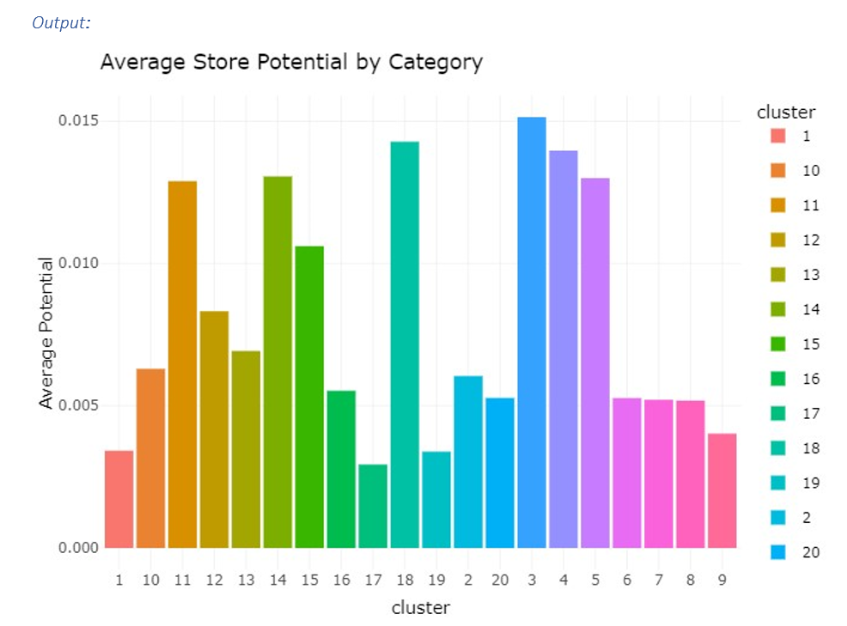
Average potential by cluster

Slide 38
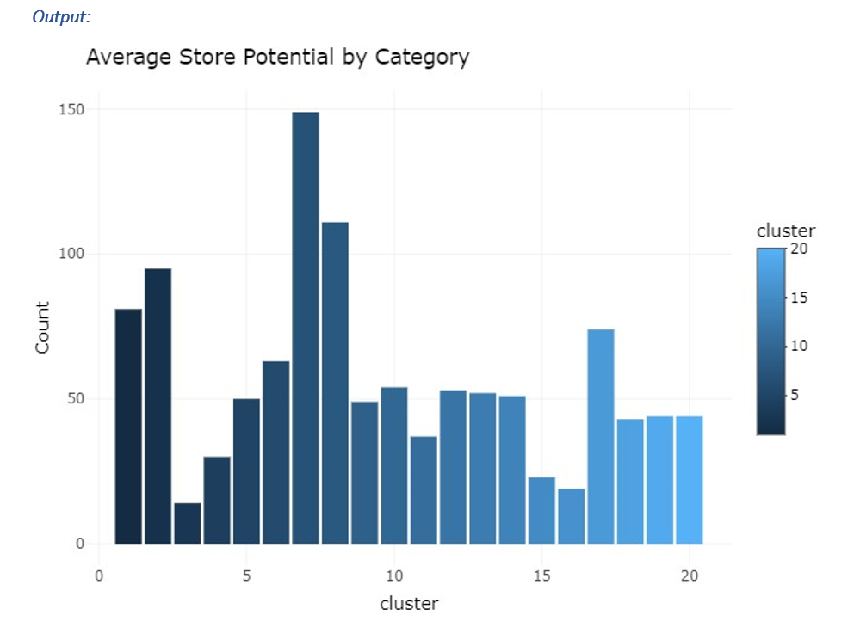
Cluster Count

Slide 39
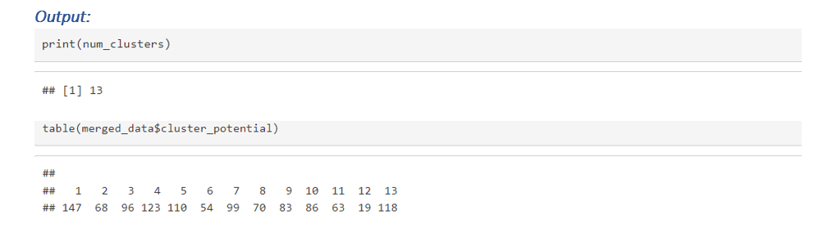
Making clusters for potential

Slide 40
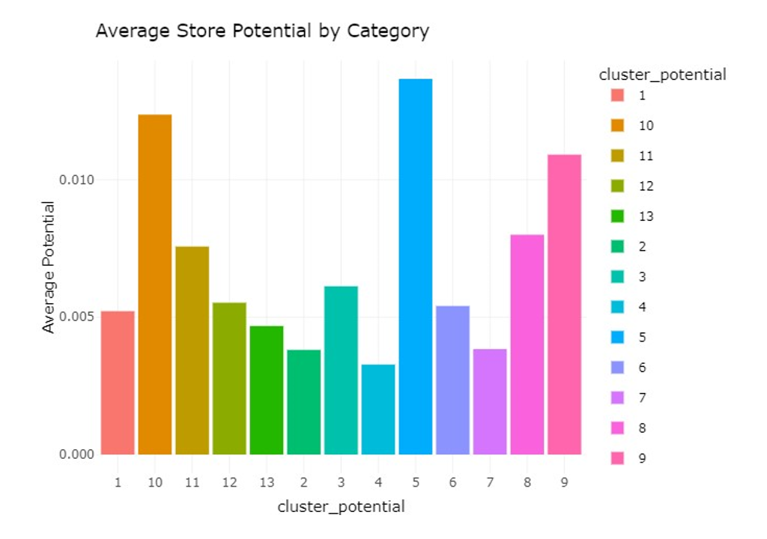
Making clusters for potential

Slide 41
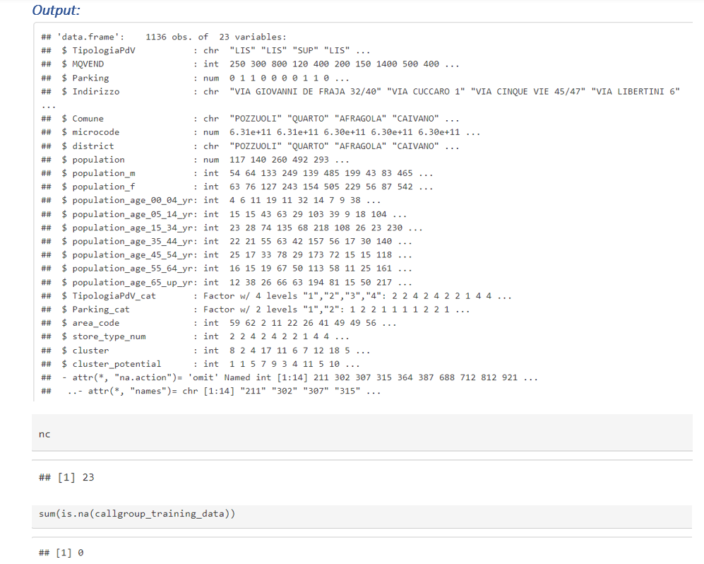
Feature Importance

Slide 42

Confirmatory Data Analysis

Slide 43
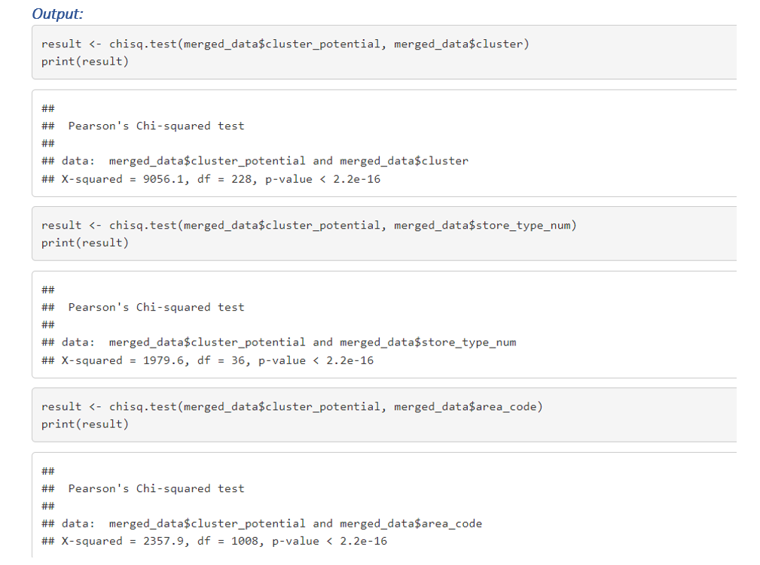
Hypothesis testing

Slide 44
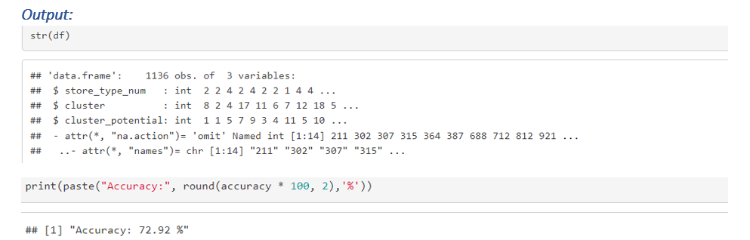
Random Forest Model

Slide 45
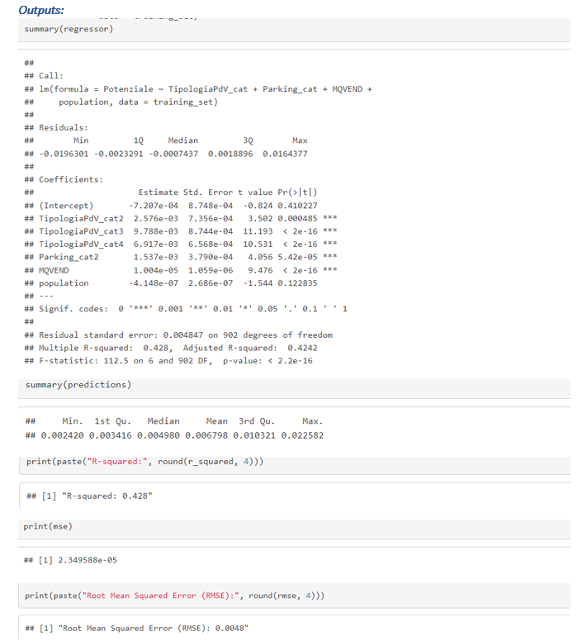
Multiple Linear regression

Slide 46
Coefficients
The intercept term is not significant (p-value: 0.4102).
Variables TipologiaPdV_cat2, TipologiaPdV_cat3, TipologiaPdV_cat4, Parking_cat2, MQVEND, and population are significant predictors (p < 0.05).
Coefficient estimates indicate the direction and magnitude of the relationships between predictors and the response variable. For instance, a one-unit increase in TipologiaPdV_cat2 increases the response variable by 0.002576 units, other variables being constant.

Slide 47
Model Fit
Multiple R-squared value indicates the model explains about 42.8% of the variance in the response variable.
Adjusted R-squared value is slightly lower, indicating additional predictors do not significantly enhance the model's explanatory power.
F-statistic is significant (p < 0.05), showing the model's overall significance in predicting the response variable.
Residual standard error is about 0.004847, measuring the typical deviation of observed from fitted values.

Slide 48
Predictor Importance
TipologiaPdV, Parking, and MQVEND are key predictors for the response variable, due to their high coefficient estimates and significance.
The variable 'population' is not statistically significant in predicting the response variable, as its p-value is 0.1228.

Slide 49

Conclusion

Slide 50
Utilized initial visualizations (box plots, density plots) to identify outliers and assess data distribution. Conducted normality tests (e.g., Kolmogorov-Smirnov test) to check variable normality. Analyzed correlations through heatmaps and pair plots; found no direct relationships between variables and the target variable. Employed K-means clustering to reveal meaningful patterns within the data. Conducted hypothesis testing and feature importance assessment with Random Forest classification, achieving 70% accuracy in predicting the target variable based on clusters. Built a multiple linear regression model including other relevant variables, providing insights into complex variable relationships. Concluded that clustering significantly enhances predictive modeling capabilities, with Random Forest and multiple linear regression models effectively capturing dataset patterns and relationships.

Slide 51
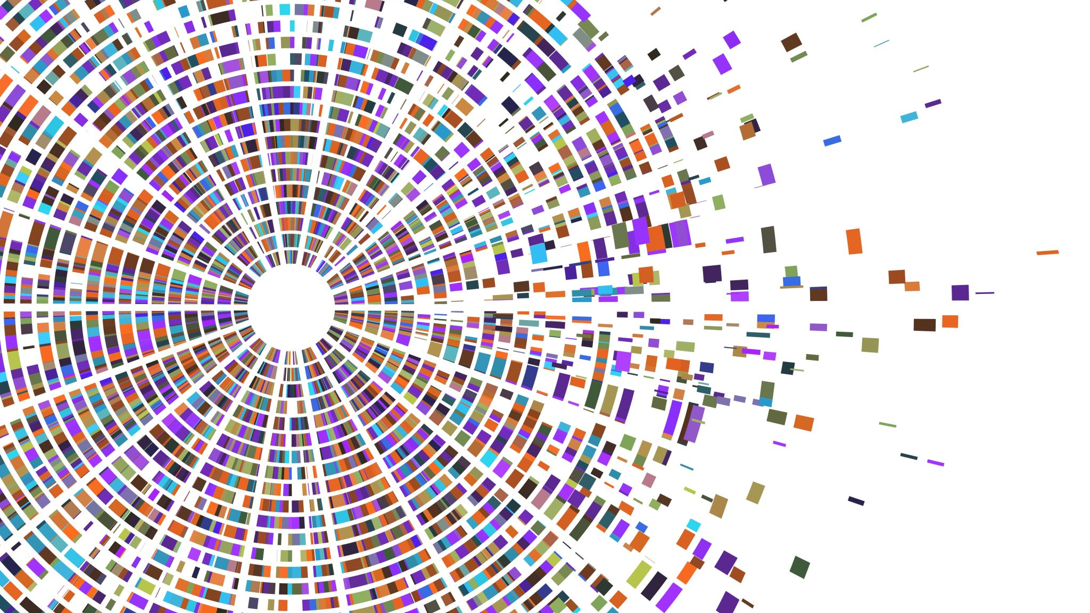
The End

